Slide 1
Topology Optimization of a Multi-tool DPPM Review 3
Course Code: MEE3502 SLOT: G1
Faculty: Dr. C. Chiranjeevi

Slide 2
TEAM MEMBERS
Our team consists of 3 members:
Aditya Jai Warrier (18BME0865)
Anirudh Bharath (18BME0750)
Avinash Nambiar (18BME0495)

Slide 3
INTRODUCTION
A multi-tool (or multitool) is a hand tool that combines several individual functions in a single unit. It mostly consists of a hammer, plier, blade, wire cutter, can opener, scissors, saw, nail file etc.
It is commonly used by cyclists to allow adjustment of bicycle fasteners during a ride, or for repairing a broken chain. For sport fishermen, a specialized multitool may combine common functions such as cutting fishing line, crimping weights, removing hooks or opening split rings.
The advantage of a multitool is saving weight and space over a set of individual tools to perform the same functions.

Slide 4
PROBLEM DEFINITION
The functionality of the multi-tool lies in the number of tools it contains. However, on adding more tools the weight becomes significantly larger and this can be an issue.
Light weightiness is an important characteristic of a multitool. In order, to keep the weight of the multitool low, we have performed a topology optimization on the individual tools.
By reducing the weight of individual tools, we can reduce the weight of the entire multitool without removing any tools.

Slide 5
SIGNIFICANCE OF WORK
Topology optimization (TO) is a mathematical method that optimizes material layout within a given design space, for a given set of loads, boundary conditions and constraints with the goal of maximizing the performance of the system.
The benefits of implementing Topology optimization to a multitool design are-
Light weight
Low material cost
More tools
Ergonomically appealing

Slide 6
METHODOLOGY
The methodology consists of 3 steps:
1. CAD modelling of multi-tool
2. Topology Optimization of selected tools
3. CAM processing of tools

Slide 7
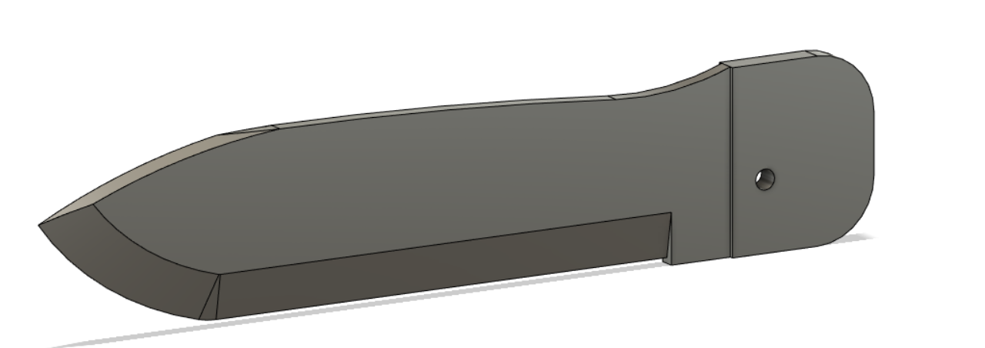
CAD Modelling
Our aim was hence focused towards the modelling of a mechanical multi utility tool. . We choose individual tools on the basis of its function and assembled them into our . multi tool. They are -
1. Knife-
A sharped edged knife is used for cutting materials such as fabrics and ropes. It can also be used for reshaping materials such as wood and can be useful for various other tasks

Slide 8
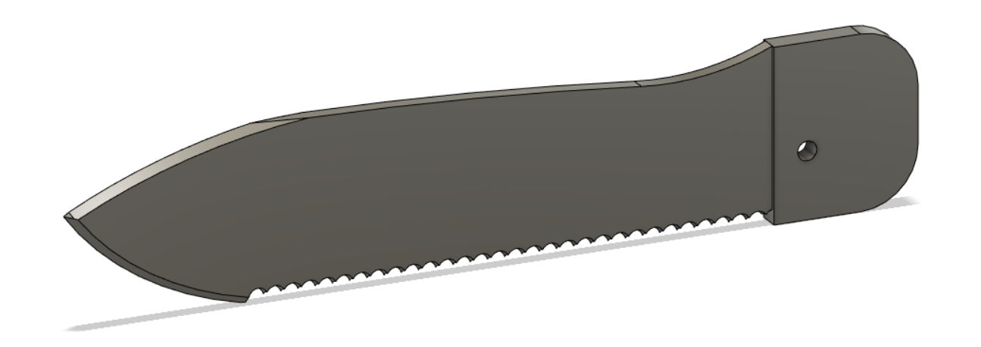
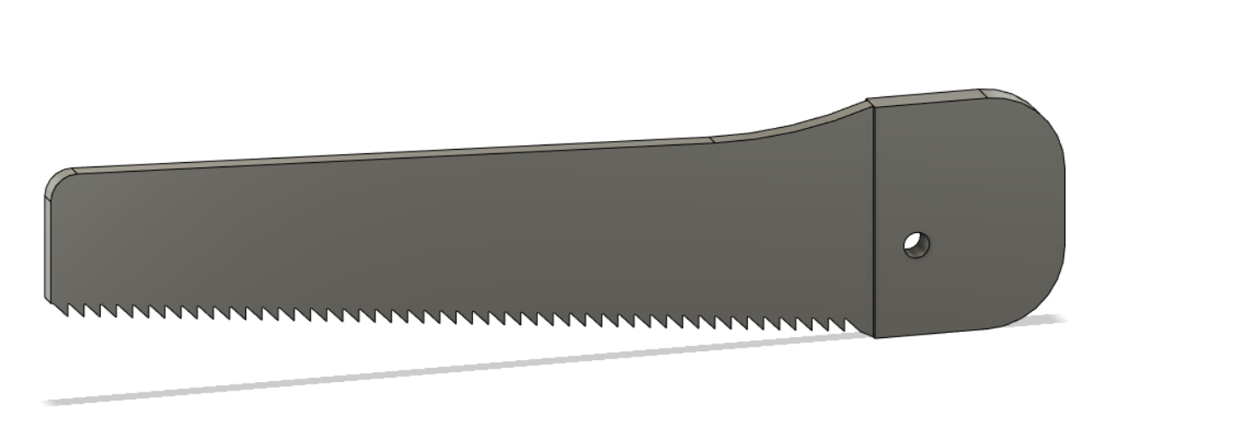
CAD Modelling
2. Serrated Knife-
3. Saw Knife-
A serrated cutting edge has many small points of contact with the material being cut. By having less contact area than a smooth blade or other edge, the applied pressure at each point of contact is greater which makes it better
A basic hand saw is a staple tool in many workshops when you need to cut fiberglass, drywall or wood.

Slide 9
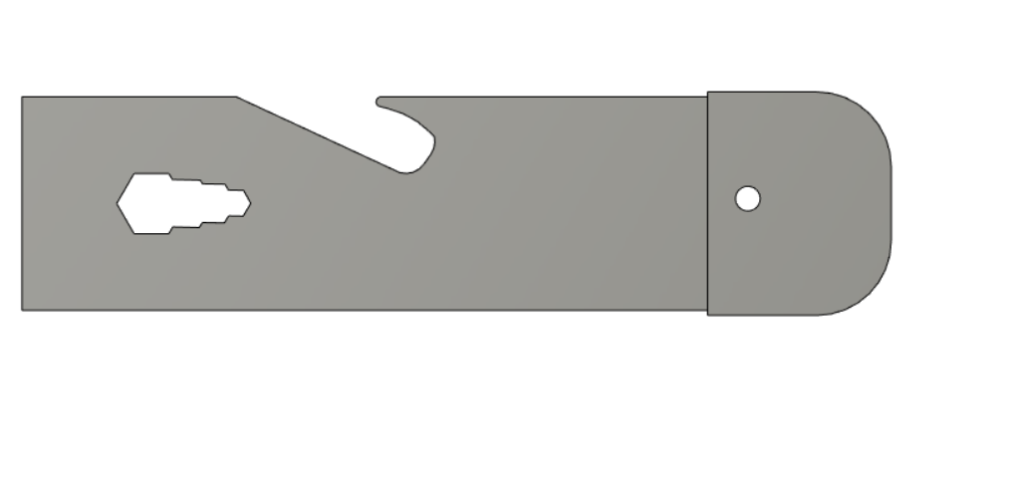
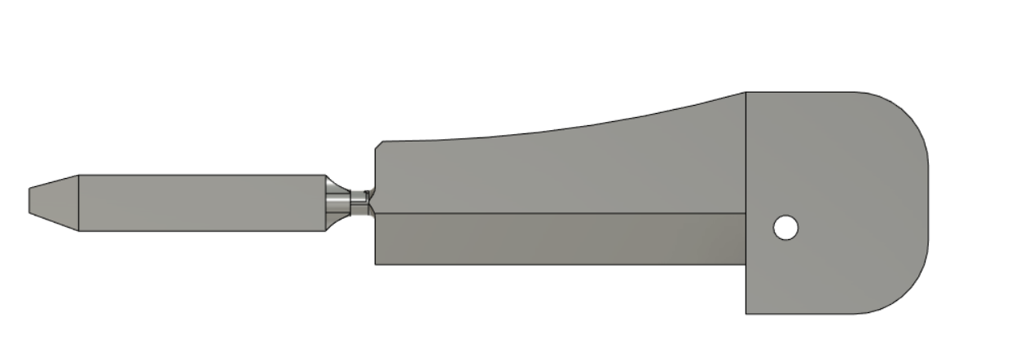
CAD Modelling
4. Wrench(also includes bottle opener)-
.
A wrench that includes various standard sizes is used. . It is used for gripping, fastening, turning, tightening . and loosening of nuts and bolts.. A bottle opener is also . included on its side.
5. Screwdriver(Modifiable)-
A modifiable screwdriver where either a Phillips/slotted . or a torx/star screwdriver can be used

Slide 10
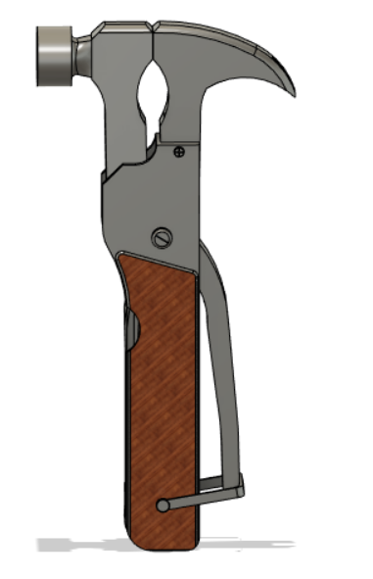
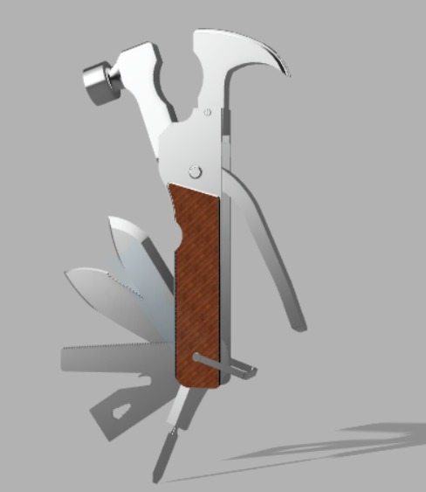
CAD Modelling
Final Assembly-
The figure includes additional tools such as
a hammer, a claw and a plier. Hence, these are all the
basic tools that are a part of our multi tool.

Slide 11
Topology Optimization
The aim of the analysis is to reduce as much mass as possible without compromising on its strength or stiffness.
The tools which were initially designed were taken as the input. The hole section in the tools were given a fixed constraint as a boundary condition.
The load taken into account was 10 Pa which is the usual range of application. This was applied to the tool according to its use.
The handle region was preserved in order to make sure that no material is removed from it. The materials used for the tools were assigned appropriately.

Slide 12
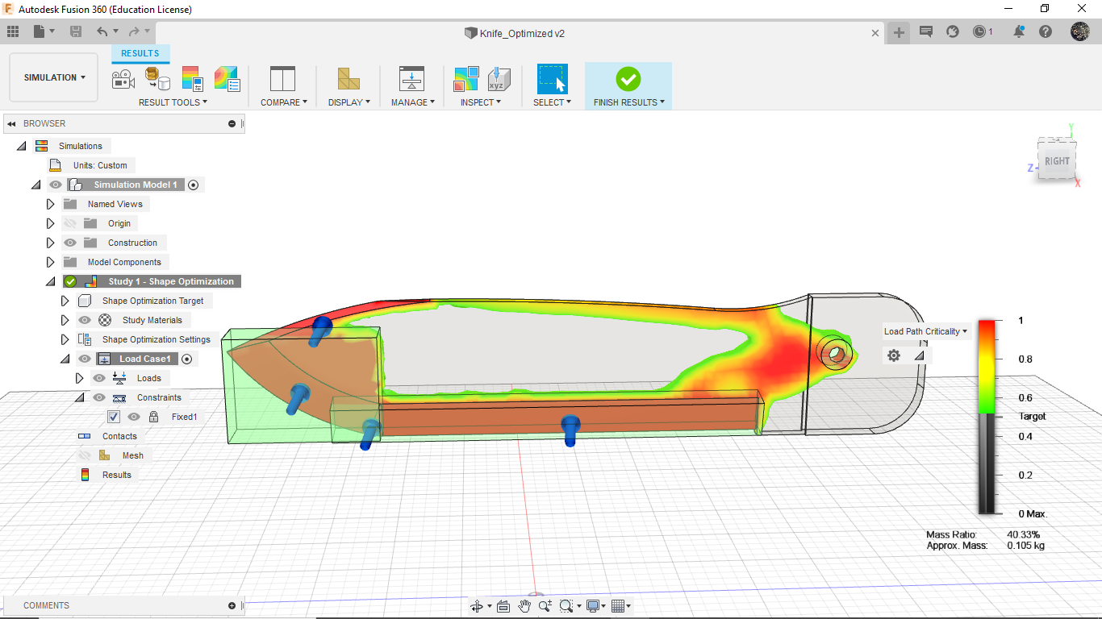
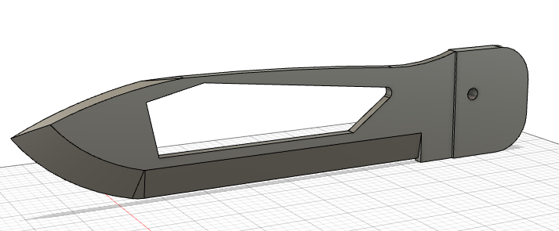
Knife Optimization
The initial mass of the knife was 89.91g and after an optimization of 25.2697%, the mass was reduced to 67.19g (approx.)

Slide 13
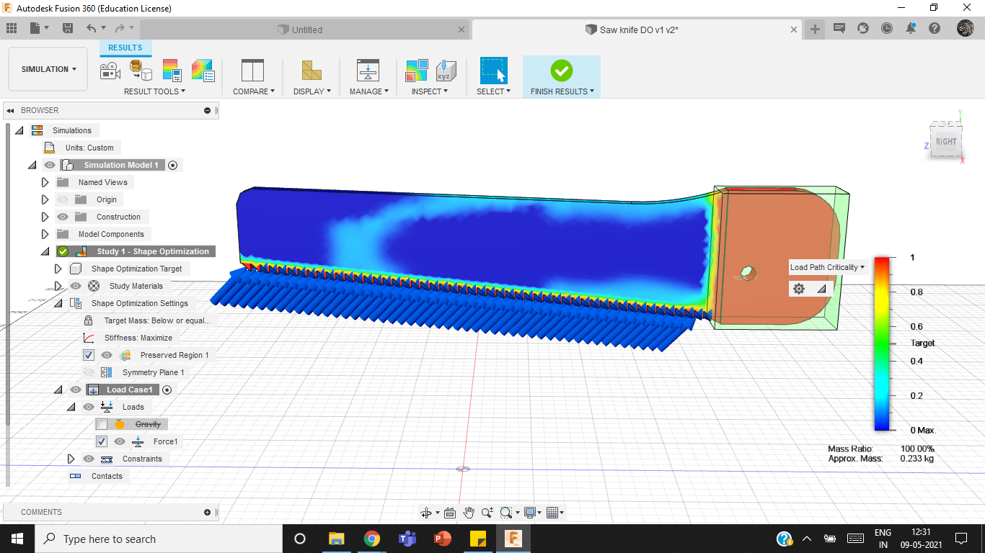
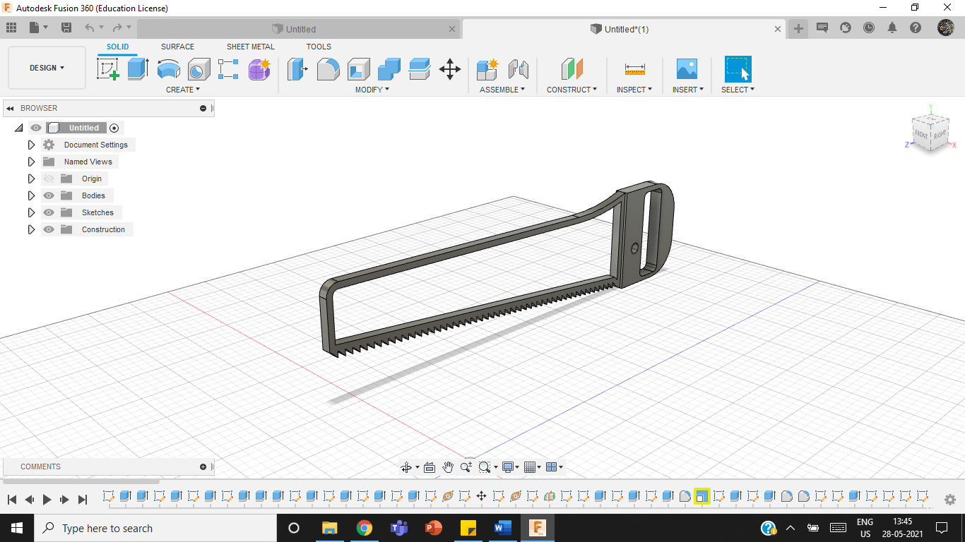
Saw Knife Optimization
The initial mass of the saw knife was 80.18g and after an optimization of 64.143%, the mass was reduced to 28.75g (approx.).

Slide 14
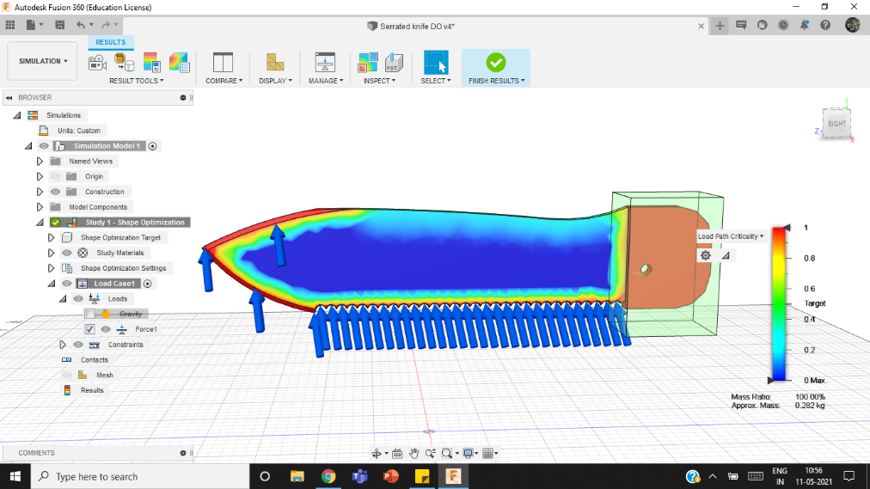
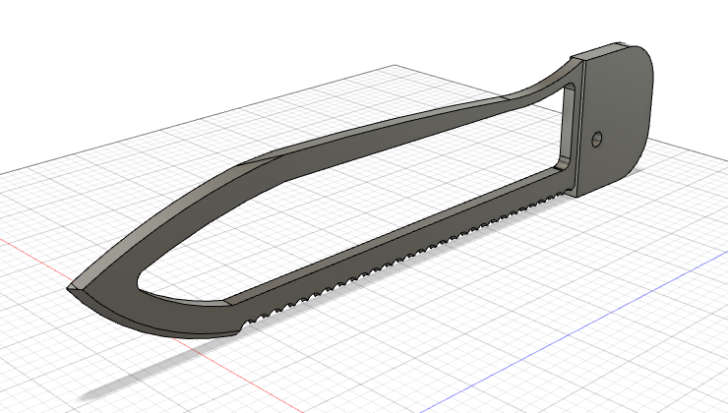
Serrated Knife Optimization
The initial mass of the serrated knife was 96.81 g and after an optimization of 45.54%, the mass was reduced to 52.72g (approx.).

Slide 15
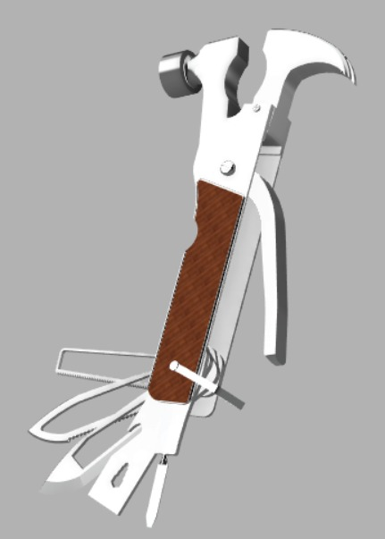
Final Design
1681.87 g
1563.63 g

Slide 16
CAM
CAM is the use of software to create detailed instructions on the manufacturing of a component.
This is represented by the G-code that is obtained once the processes are complete.
CAM is preferred for many reasons over other processes as it has greater speed as well as has greater accuracy and consistency.
We will be manufacturing the optimised tools using various CAM process that are available to us.

Slide 17
CAM
The various processes we used include :
Facing: is the process of removing metal from the end of a workpiece to produce a flat surface. It is done to provide a true, flat surface, square with the axis of the workpieces.
2D Pocketing : is the process of providing a clear & sharp boundary removing the excess material from the sides.
Boring : is the process of making a whole and removing the material.
Adaptive clearing: is a process that is used to remove a large amount of material. It guarantees maximum load on the tool during the entirety of the machining process. It also decreases the breakage of the tool thus making it efficient. It can be used for achieving very fine details which may not be possible otherwise. For Aluminium, it is recommended that the depth of cut is about 1.5-2 times the diameter of the tool.

Slide 18
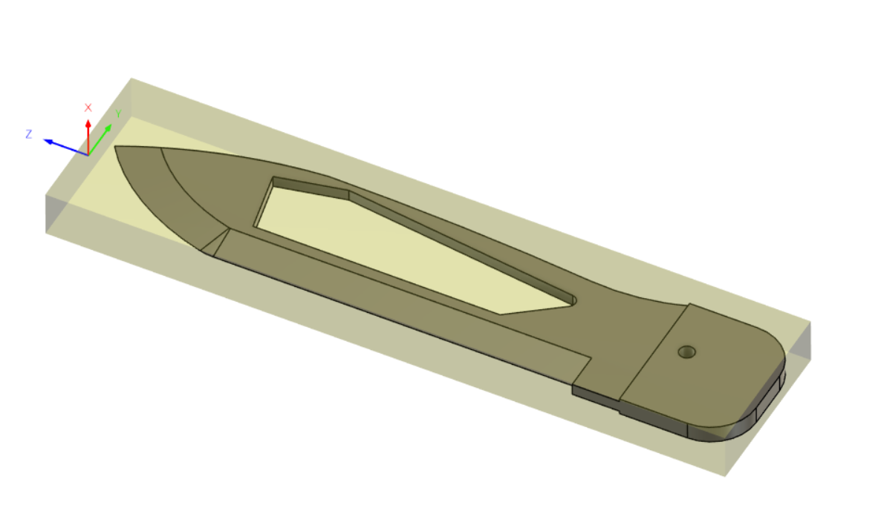
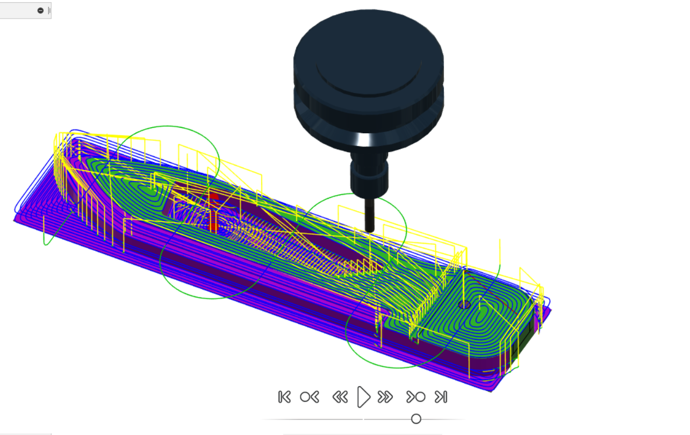
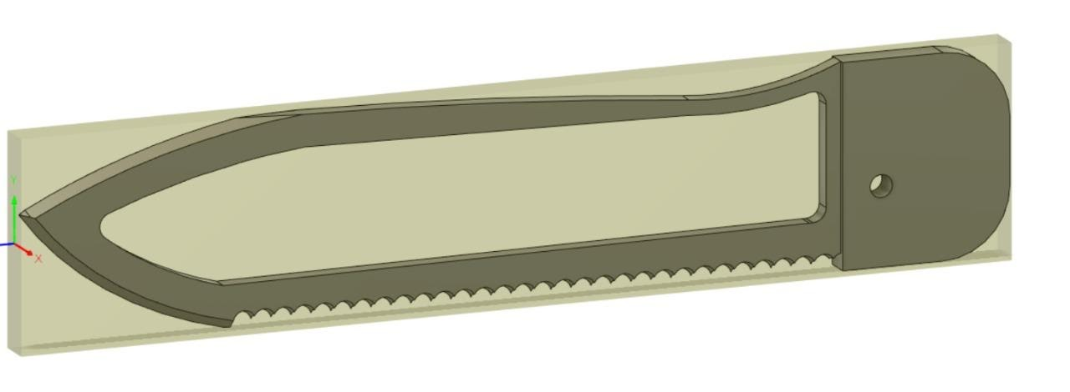
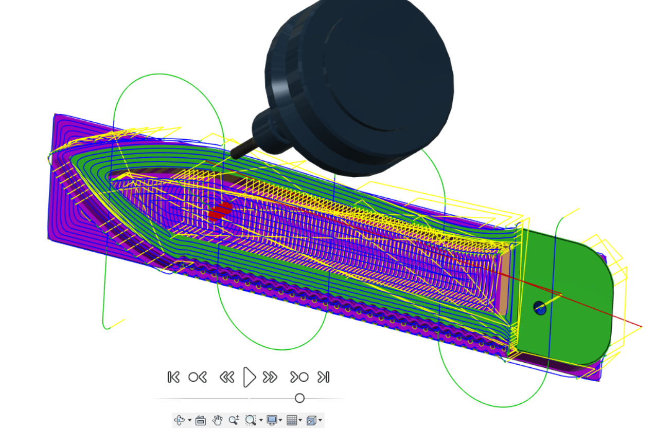

Slide 19
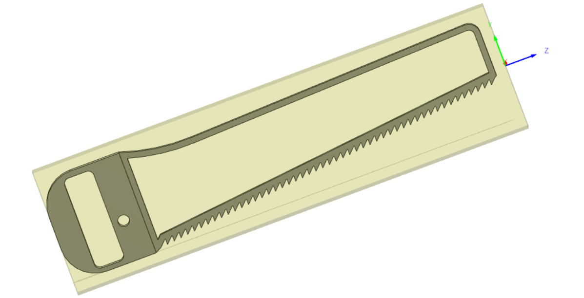
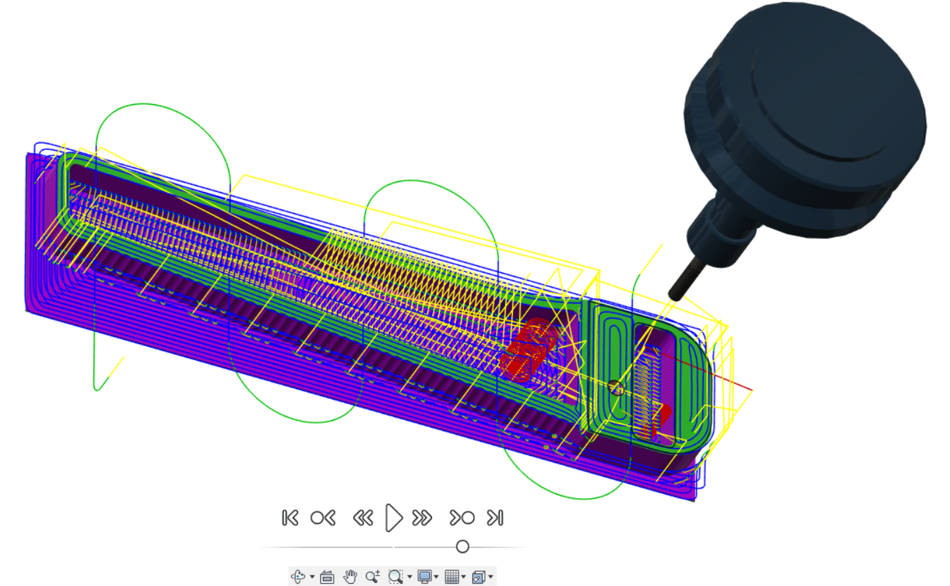
https://drive.google.com/drive/folders/133MXWJp0mIL-2F_luPqE3wnZ93kstt86?usp=sharing

Slide 20
CONCLUSION
The multi-tool was modelled on Fusion 360 including tools like hammer, plier, nose plier, wire cutter, claw, bottle opener, knife, saw knife, serrated knife and a slot for attaching any type of screw head. The weight before the analysis was around 1681.87 g.
A topology optimization was carried on 3 tools- knife, saw, and serrated knife. A weight reduction of 40.33%, 40.06% and 41.98% was achieved respectively.
The tools were re-designed according to the analysis and the final product was assembled. Each of these tools were then manufactured using CAM processes and the G codes were generated accordingly.
The final weight was around 1563.63 g. The total weight reduction was around 7% or 118.24g.

Slide 21
THANK YOU

